Slide 1

PLAYLIST RECOMMENDER
DIALOGUE SYSTEMS
COURSE PROJECT
KATE VILORIA

Slide 2
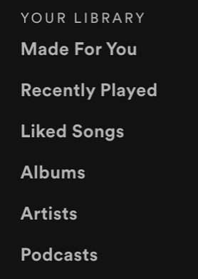
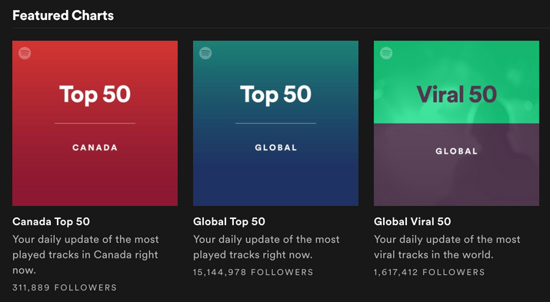
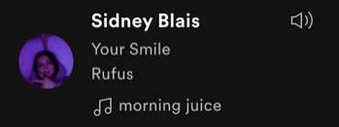
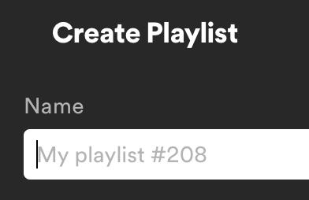
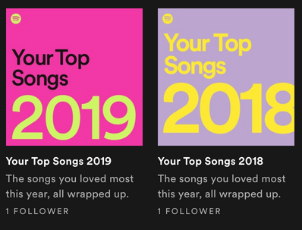

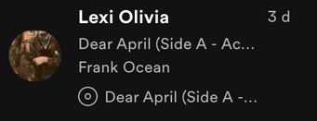
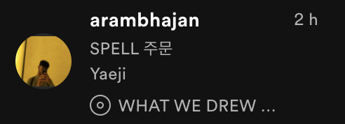
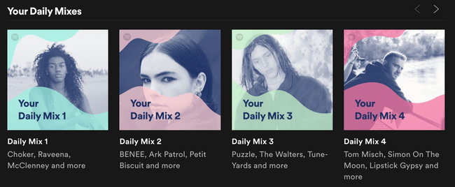
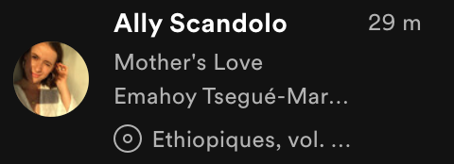
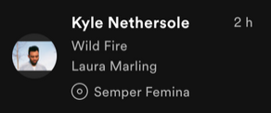
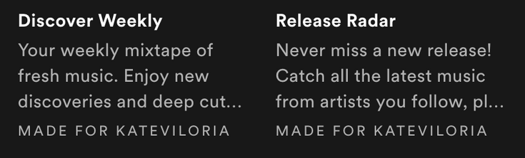

What is it?
02
!!!DECISIONS!!!

Slide 3
What does it do?
03
What's your name?
How are you doing today?
Do you want to relax or do you want to dance?
Are you the nostalgic type?
Are you tired?
A crazy night out at a club or a chill get together with friends?
Are you sad or mad?
Do you miss someone?
Would you rather sulk or scream into a pillow?
Can I choose for you?
QUESTIONS

Slide 4



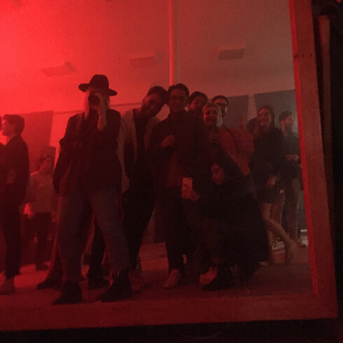

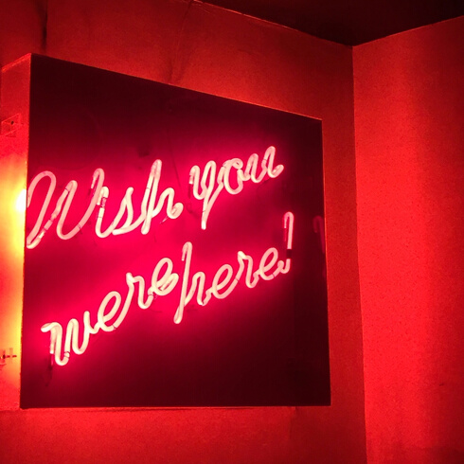
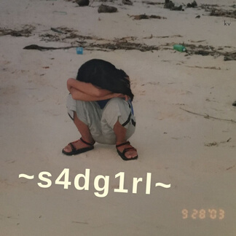
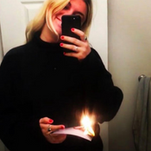

Hi! What's your name?
04
How are you doing today?
🙂
🙁
Do you want to relax or do you want to dance?
Are you
sad or mad?
🕺💃
In the kitchen or at the club?
dance
sad
mad
relax
😿
😡
☺️
Do you miss someone?
Would you rather sulk or scream into a pillow?
Are you the nostalgic type?
Finite State Machine
🧑‍🍳
🍻
👍
👎
kitchen
club
Are you
tired?
👍
👎
scream
sulk
🗣
🥺
👎
👍

Slide 5
Technicalities
05
- based on RASA book a meeting assignment
❣️🥰👍
💔😿👎
pipeline: supervised_embeddings
policies:
- name: AugmentedMemoizationPolicy
max_history: 3
- name: FallbackPolicy
nlu_threshold: 0.4
core_threshold: 0.3
fallback_action_name: action_default_fallback
pretrained_embeddings_spacy
- SpacyEntityExtractor

Slide 6
Hi! What's your name?
06
How are you doing today?
🙂
🙁
Do you want to relax or do you want to dance?
Are you
sad or mad?
🕺💃
In the kitchen or at the club?
dance
sad
mad
relax
😿
😡
☺️
Do you miss someone?
Would you rather sulk or scream into a pillow?
Are you the nostalgic type?
👍
👎
🧑‍🍳
🍻
Demo 1
kitchen
club
Are you
tired?
👍
👎
scream
sulk
🗣
🥺
👎
👍

Slide 7
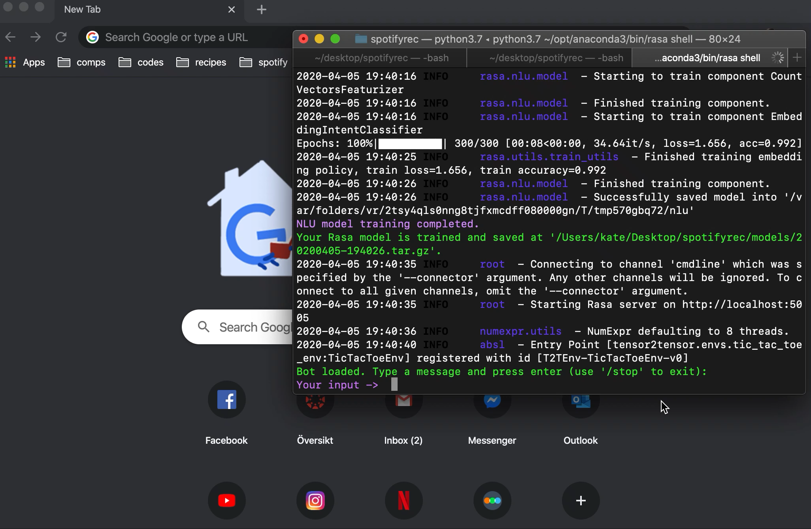
06.5
Demo 1
INPUTS
hi
kyle
great
relax
n/nostalgic
y/tired

Slide 8
Challenges
07
- initial decision tree
- name recognition
- NLU
- negation
("not so good", "not bad")
- relative ("The second one.")
- pretrained embeddings
- no answer ("I don't know.")
- first RASA assignment
- Fallback Policy
- more training data
- synonyms
- paraphrasing
- supervised embeddings
- new story
PROBLEMS
SOLUTIONS

Slide 9
Hi! What's your name?
08
How are you doing today?
🙂
🙁
Do you want to relax or do you want to dance?
Are you
sad or mad?
🕺💃
In the kitchen or at the club?
dance
sad
mad
relax
😿
😡
☺️
Do you miss someone?
Would you rather sulk or scream into a pillow?
Are you the nostalgic type?
👍
👎
🧑‍🍳
🍻
Demo 2
kitchen
club
Are you
tired?
👍
👎
scream
sulk
🗣
🥺
👎
👍

Slide 10
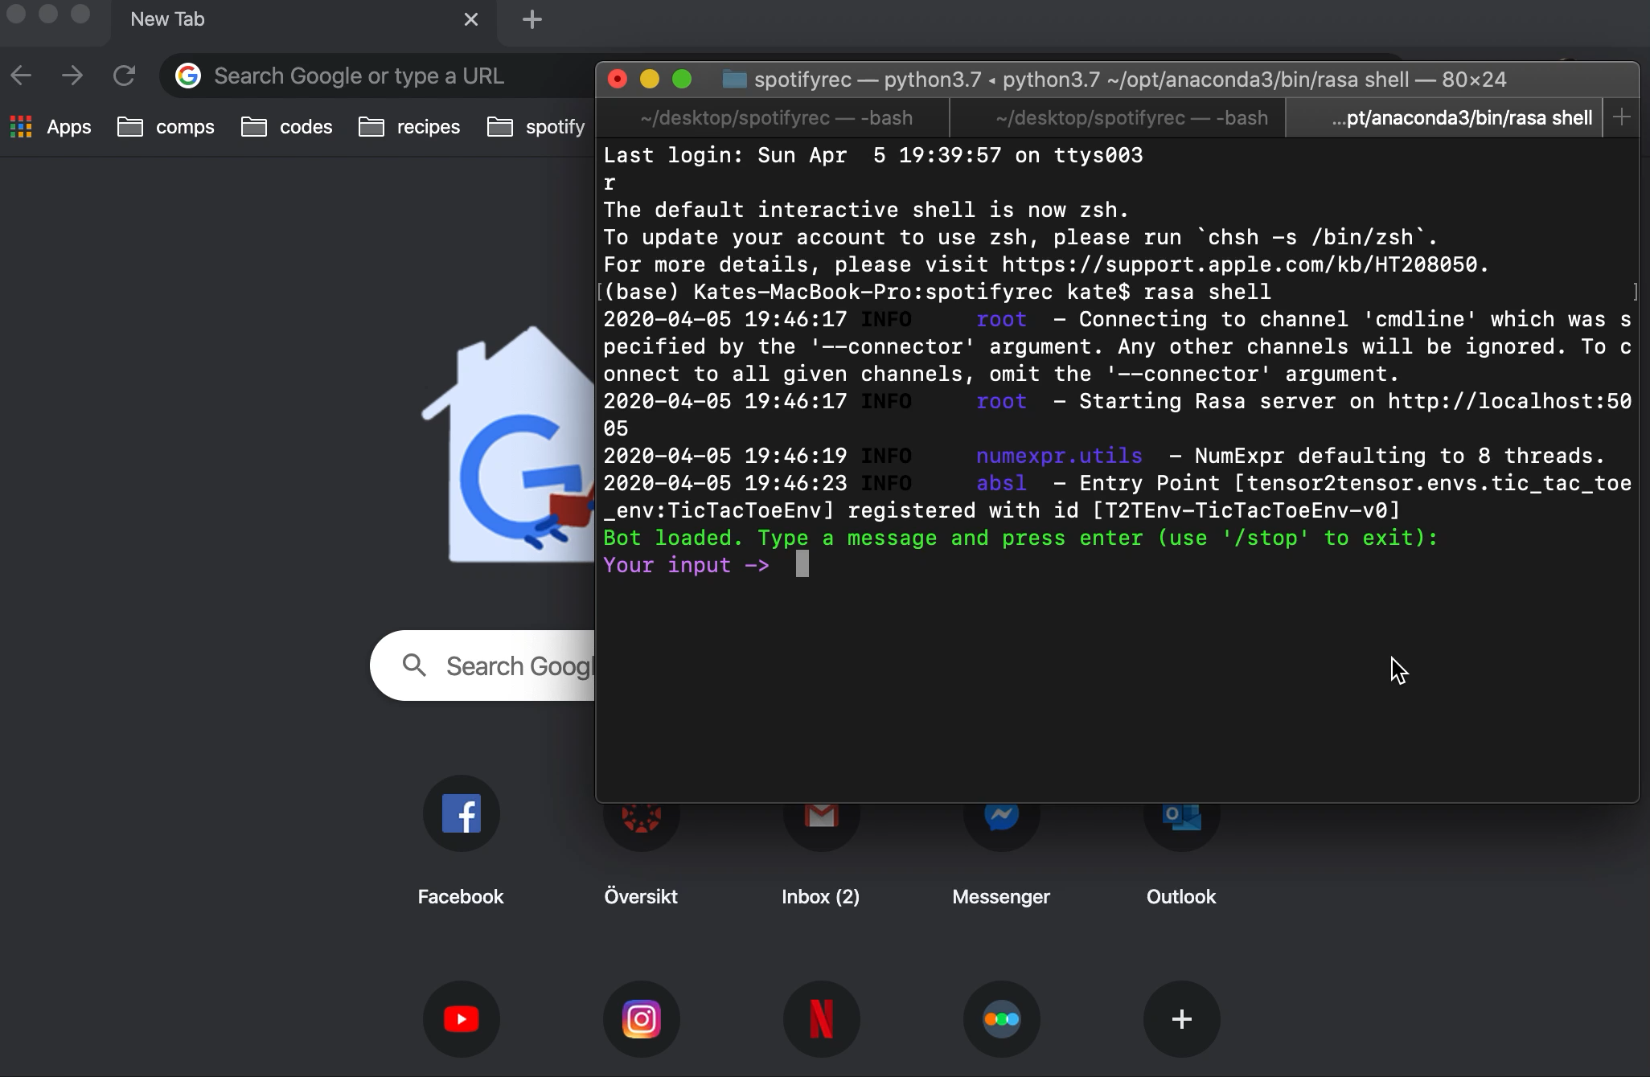
08.5
Demo 2
rephrase
+
name
extraction
INPUTS
hiya
konstantinos
my name is
## bad
mad
scream

Slide 11

09
Demo 3
no
answer
¯\_(ツ)_/¯
INPUTS
hey there
Vanessa
IDK
sure

Slide 12
Course Content
LT2116
Dialogue Systems
10
RASA IN-CLASS TUTORIALS
RASA NLU
LAB REPORT
RASA MASTERCLASS
- understanding intents, entities, slots, forms, and actions
- flow chart
- using "rasa shell nlu" to see how intents are being mapped and how to improve training data
- learned about pretrained and supervised embeddings
- Fallback Policy

Slide 13
SPOTIFY API
MULTIPLE RECS
11
- access to Spotify playlists and how they are "tagged" (metadata)
- each end state will have a pool of playlists to randomly choose from
Future Work
FORM FORMAT
ENTITY EXTRACTION
- not binary
- more open-ended questions
- open-ended questions where answers map to playlist characteristics (weather, colour, vibe, sounds like, etc.)
- the playlist with the highest match is recommended
How could this chatbot be developed?

Slide 14
End
12
Thank You!!
TACK!
GRACIAS!
MERCI!

